Slide 1
Applying Models to Apps
The Team 10 Scam Patrol:
Asa Adomatis, Laxmi Atluri, Xavier Figueroa,
Kevin Miller, Sara Moujahed, and Pablo Romero

Slide 2
Our Goal
References:
https://www.forbes.com/sites/rachelwells/2024/08/13/36-of-job-adverts-are-fake-how-to-spot-them-in-2024/
https://www.cnbc.com/2024/08/22/ghost-jobs-why-fake-job-listings-are-on-the-rise.html
https://www.wsj.com/lifestyle/careers/ghost-jobs-2c0dcd4e?mod=mhp
-Job applications are tiring, tedious, and time-consuming
-An estimated 36% aren’t even real postings!
-Can we create a model that can accurately identify fake job postings, saving users from wasting significant time and energy?
Notes:
Forbes: 36% of job postings are fake
CNBC: 4 in 10 companies have posted fake/”ghost” jobs in 2024, 3/10 actively have fake postings; additionally, the hiring rate per job has halved (4/10) since 2019 (8/10)
Important because it’s difficult to accurately gauge the strength of the US job market
WSJ: citing hiring platform Greenhouse: 18-22% of technology, finance, and healthcare jobs are fake; 70% of 7500+ companies using Greenhouse posted 1+ fake job in the second quarter of 2024

Slide 3
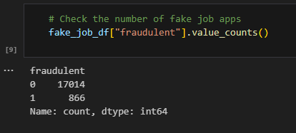
Methodology
-We used the “Recruitment Scam“ dataset from Kaggle
-17,880 total job postings
-866 confirmed fake postings
-18 different categories
-Various data cleaning
https://www.kaggle.com/datasets/amruthjithrajvr/recruitment-scam
Notes:
18 different categories include: location, department, salary range, job description, and the target column we used for training data: fraudulent
We used supervised models in a final binary classification
Note significant discrepancy in verified/fraudulent postings
We removed null values, scaled our data, removed stop words (words like “and” or “the” that have minimal value without context), and vectorization (go to next slide)

Slide 4
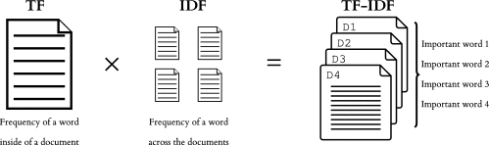
Vectorization and
Vector Databases
-Significant amounts of text needs converting into a “Vector Database” to classify
-TF-IDF: Term Frequency - Inverse Document Frequency
-Grid Search
Notes:
Vectorization: EXPLAIN
Vectorization in regards to a Vector Database: Converts unstructured and complex data (like text) into numeric representation; when combined with approximate nearest neighbor algorithms, is the process behind chatbots
Vectorization can also refer to running looped programs simultaneously for increased speed and efficiency

Slide 5

Optimization
-Resampled data using SMOTEEN to fix the imbalance within the dataset of non-fraudulent to fraudulent which had a ratio of 18:1
-SMOTEEN was the best choice for the dataset due to its more balanced approach compared to over and under sampling

Slide 6
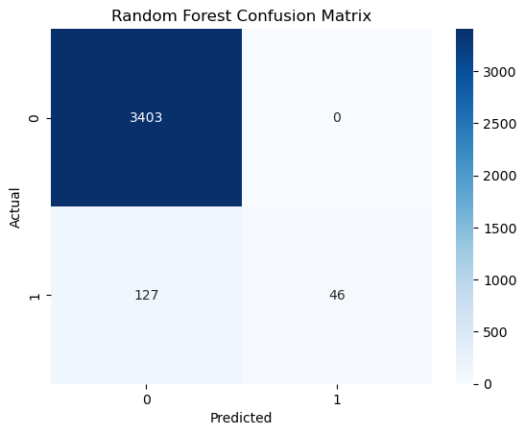
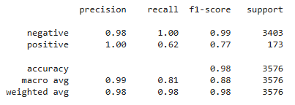
Model 1: Random Forest Model
-Able to identify 62% of fraudulent results in testing data
-F-1 Score: 0.77
-Displayed perfect recall for genuine postings
Notes:
Used grid search on each model to improve performance

Slide 7
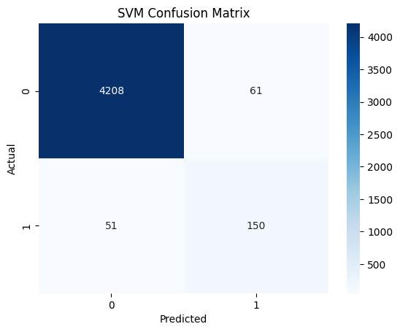
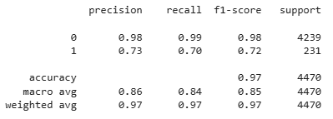
Model 2: SVM (Support Vector Machine)
-Able to identify 70% of fraudulent postings
-F-1 Score: 0.72
-Slight overall trade-off for better accuracy with fraudulent postings
Notes:
Note slight trade off between identifying genuine job postings and a slightly higher percentage of fraudulent ones

Slide 8

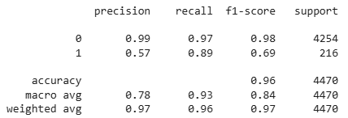
Model 3: Multinomial Naive Bayes
-Able to identify 86% of fraudulent postings
-F-1 Score: 0.69
-Model is typically used for spam detection, but was still lowest scoring
Notes:
Multinomial Naive Bayes is a classifier where sequential events determine probabilistic outcomes, and is most typically used with frequency counts like in spam detection, yet still was our lowest-scoring model overall
Also tested Decision tree and Logistic Regression models

Slide 9
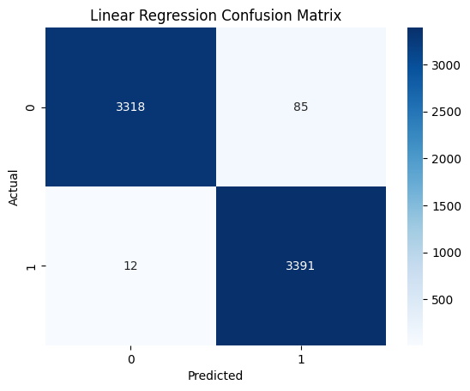
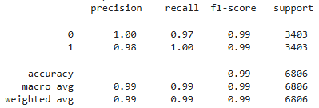
Model 4: Linear Regression
-Able to identify 99% of fraudulent postings
-F1 Score: 0.99
-Near-perfect accuracy when identifying fraudulent postings
Notes:
We used SMOTE (oversampling) to create a more balanced dataset for our LR model, and drastically increased the model’s accuracy

Slide 10
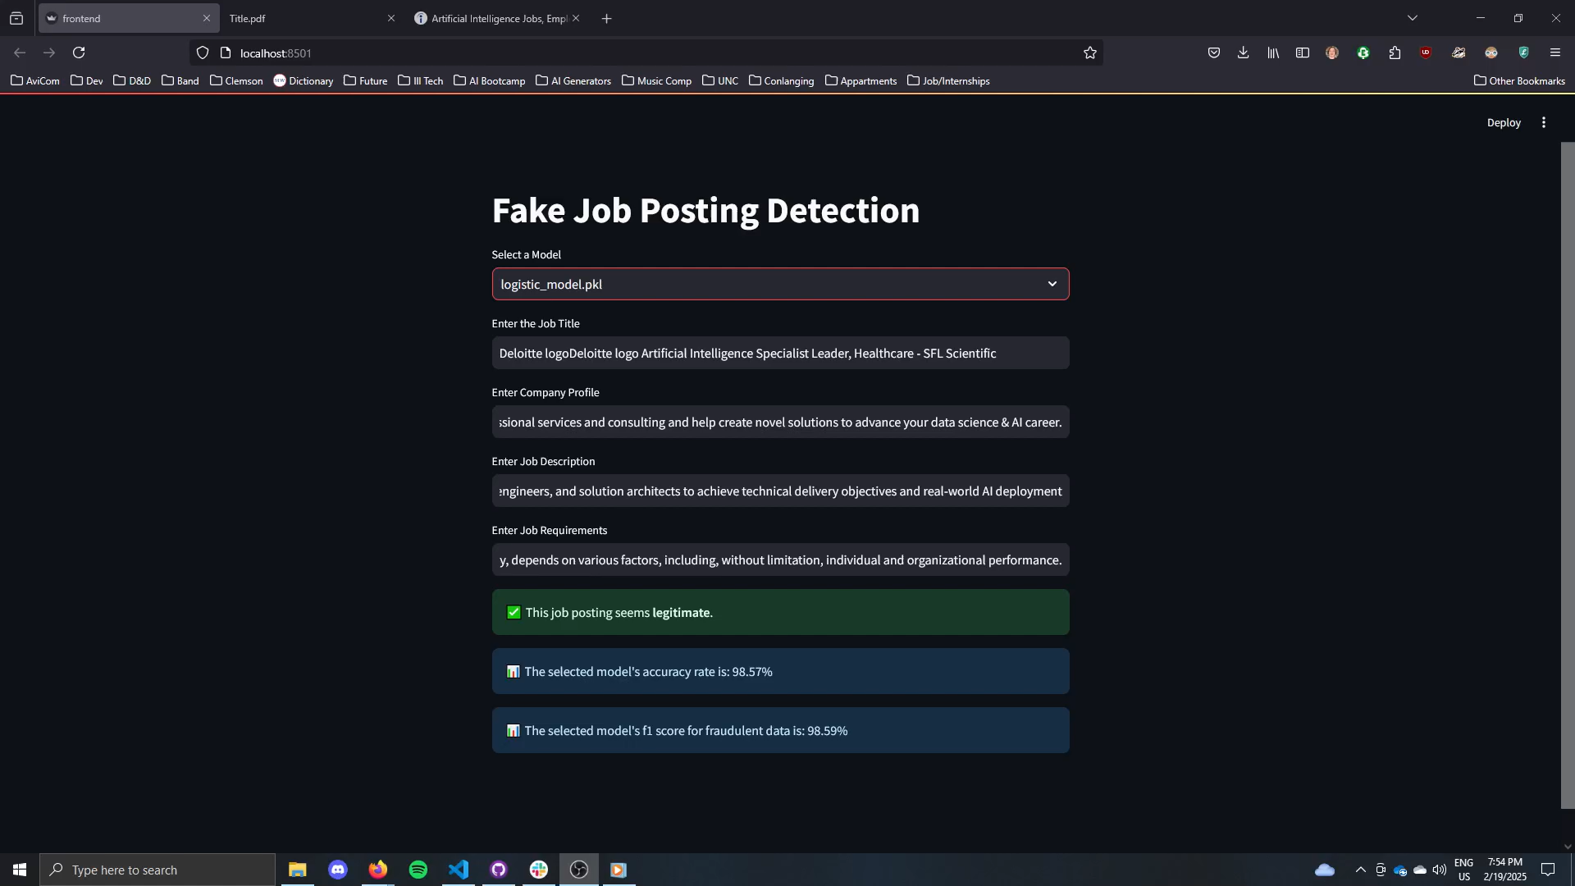
Demo

Slide 11

Future Work
- Using the same pipeline and preprocessing sooner
- Grid Searches take significant amounts of time to run
- Could test variations and other models entirely
- Can we apply this process to identify other “fraudulent” text-based items?
Notes:
Uniform preprocessing and creating a pipeline sooner would solve a lot of headaches
Running grid searches takes a *significant* amount of time and could use refining
There are other ways to vectorize data, such as a “bag of words” term frequency instead of just the TF-IDF
Could we identify spam or AI text using our models?

Slide 12

Conclusion
Which model worked best?
Linear Regression
How accurate is it?
99% accurate according to the f1-score, with a weighted average of 99%
Notes:
Compared based on f1 score because it shows the times it correctly identified fraudulent postings and instances where it did not as well
Focused on fraudulent postings because that was what we wanted to be accurately predicted

Slide 13
Good Luck on Your Job Hunts!
Notes:
Unfortunately, we have yet to develop the app that fills out your application, but at least you know if it’s genuine or not!

